Slide 1
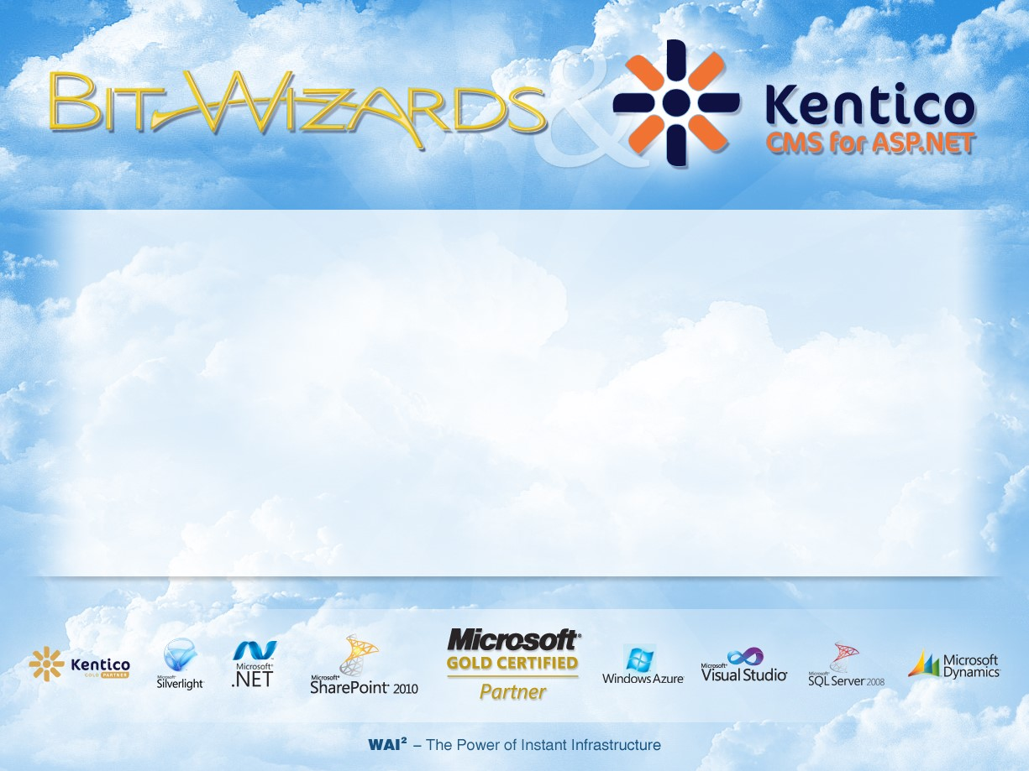
What is the Cloud?

Slide 2
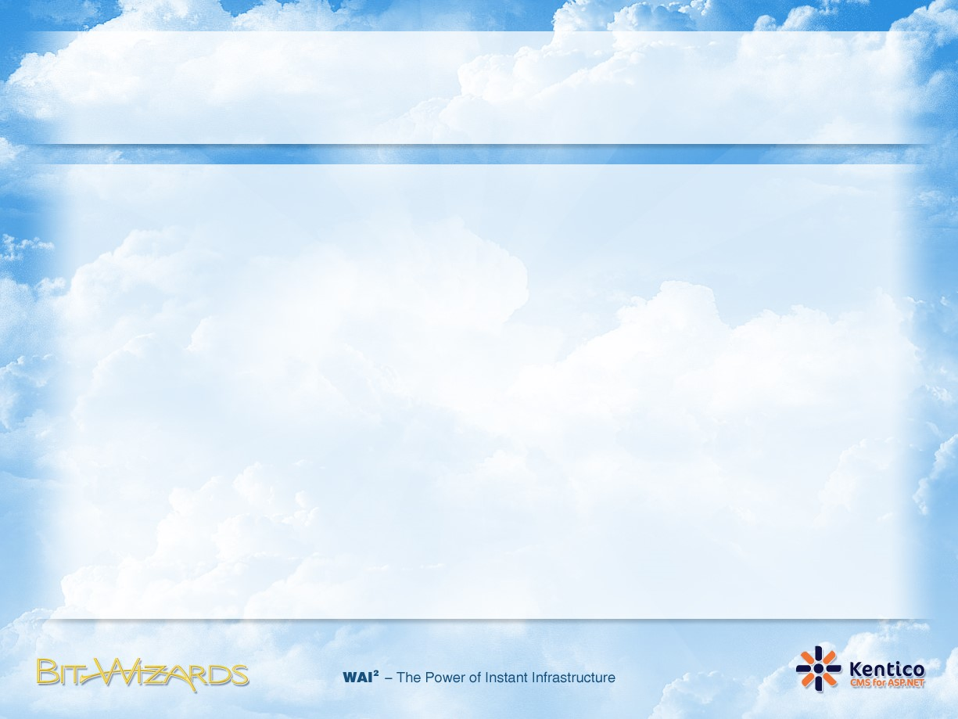



Cloud Computing in a Nutshell
Cloud Computing is the transformation of computer hardware, software and networks into a Utility just like the your Electric Company, Water Company, or Gas Company.
1 instance runs 1000 h = 1000 instances run 1 h

Slide 3
Defining the Cloud
Characteristics
"Cloud computing is a model for enabling convenient, on-demand network access to a shared pool of configurable computing resources (e.g., networks, servers, storage, applications, and services) that can be rapidly provisioned and released with minimal management effort or service provider interaction.
On Demand
Scalable / Rapid Elasticity
Multi-Tenant
Self Service
Reliability
Utility Based Subscription
Notes:
On-demand - Resources should be always available when you need them, and you have control over turning them on or off to ensure there’s no lack of resource or wastage happen.
Scalable - You should be able to scale (increase or decrease the resource) when necessary. The cloud providers should have sufficient capacity to meet customer’s needs.
Multi-tenant - Sometimes you may be sharing the same resource (e.g. hardware) with another tenant. But of course, this is transparent to the customer. Cloud provider shall responsible the security aspect, ensuring that one tenant won’t be able to access other’s data.
Self-service computation and storage resource - Related processes including: billing, resource provisioning, and deployment should be self-service and automated, involving much less manual processing. If a machine where our service is hosted fails, the cloud provider should be able to failover our service immediately.
Reliability - Cloud provider should be able to provide customer reliability service, committing to uptimes of their service.
Utility-based subscription - You will pay the cloud provider as a utility based subscription, just like paying your electricity bill – without any upfront investment.

Slide 4
Defining the Cloud
Deployment Models
Service Models
Private Cloud
Public Cloud
Hybrid Cloud
Infrastructure as a Service
(IaaS)
Platform as a Service
PaaS
Software as a Service
SaaS
Notes:
Public Cloud Public cloud provider refers to the cloud platform that targets any types of customers, regardless of whether they’re an independent consumer, enterprise, or even public sector. Normally, public cloud providers are considered prominent players which have invested huge amount of capital. Windows Azure Platform by Microsoft, AWS by Amazon, AppEngine and Gmail by Google, etc. are all examples of public cloud services. Customers who possess sensitive data and application normally do not feel comfortable using public cloud due to privacy, policy, and security concerns. Remember, for public cloud, the application and data will be stored in the provider’s data center.
Private Cloud Private cloud is infrastructure that’s hosted internally, targeting specific customers or sometimes exclusively within an organization. Setting up a private cloud is normally more affordable when compared to a public cloud. As the matter of fact, there are many organizations who have implemented their own private cloud system with product offering from vendors such as IBM, HP, Microsoft, and so on. Customers who possess sensitive data and application feel more comfortable going with this approach since the data and application are hosted privately.
Hybrid Cloud Hybrid cloud is the combination of public and private clouds, or sometimes on-premise services. Customers who look into this solution generally want to utilize the scalability and cost-competitiveness that public cloud providers offer, but also want to retain their sensitive data on-premise or in a private cloud. With the benefits derived from both deployment models, the hybrid model solution has become more popular nowadays.
IaaS (Infrastructure as a Service) IaaS helps you to take care of some of the components, starting from networking to provisioning the OS. But you are responsible for the middleware, runtime, data, and application. Sometimes IaaS vendors will just provide the OS but will not manage updates or patches for you. You basically just rent the virtual machine (VM) with the preferred OS installed. They won’t care what you do with the VM. Example of IaaS market players: Amazon Web Service, Rackspace, and VMware vCloud.
PaaS (Platform as a Service) Paas is one level up from IaaS, where cloud providers not only take care of the components that IaaS does; but also manage the platform-level components like middleware and runtime. Middleware such as applications / web server (IIS, JBoss, Tomcat, etc.) and runtime (.NET Framework, Java runtime) will be pre-installed. As a customer, you just need to focus on managing application and data. Example of PaaS market player: Google AppEngine, Windows Azure Platform, and force.com.
SaaS (Software as a Service) SaaS is probably the most common one as we may have been using it, unaware that they are actually cloud services. SaaS takes care of all the stacks from networking to application level. You don’t even manage the application and data storage. All you need to do is to use the system. Example of SaaS market player: GMail, Office 365, and Google Docs.

Slide 5
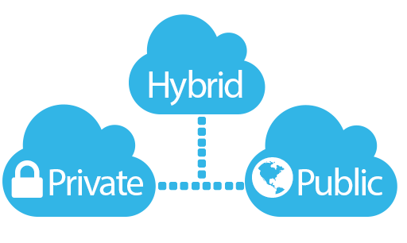
Cloud deployment models

Slide 6
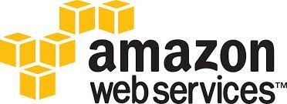



Public Cloud
Providers let clients access the cloud via Internet
Made available to the general public

Slide 7
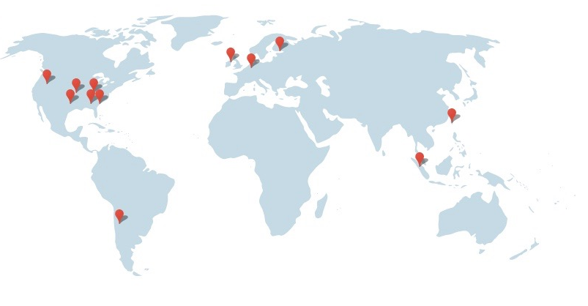
Public Cloud
Multi-tenant virtualization, global-scale infrastructure
Functions and pricing vary
Copyright: Google

Slide 8
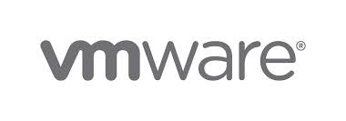
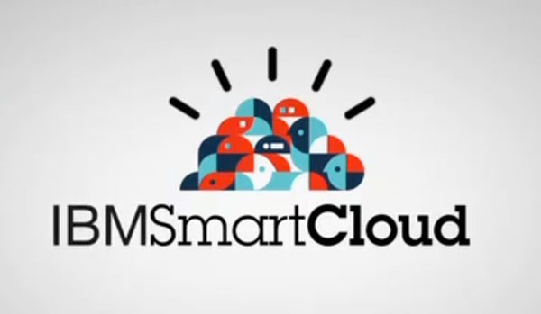
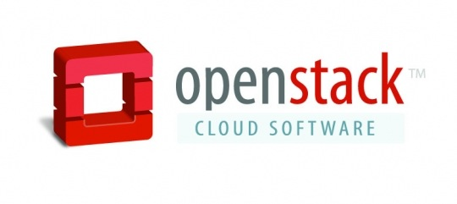
Private Cloud
The cloud is used solely by an organization (e.g. HKUST, Facebook, HSBC)
May reside in-house or off-premise

Slide 9
Private Cloud
Secure, dedicated infrastructure with the benefits of on-demand provisioning
Not burdened by network bandwidth and availability issues and security threats associated with public clouds.
Greater control, security, and resilience.

Slide 10
Hybrid Cloud
Composed of multiple clouds (private, public, etc.) that remain independent entities, but interoperate using standard or proprietary protocols
Banks, hospitals, government

Slide 11
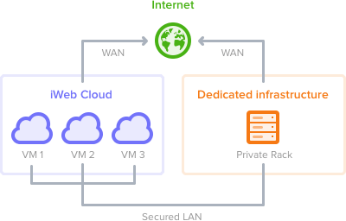
Hybrid Cloud
Allows applications and data to flow across clouds
Copyright: iWeb

Slide 12
Cloud Service Models

Slide 13
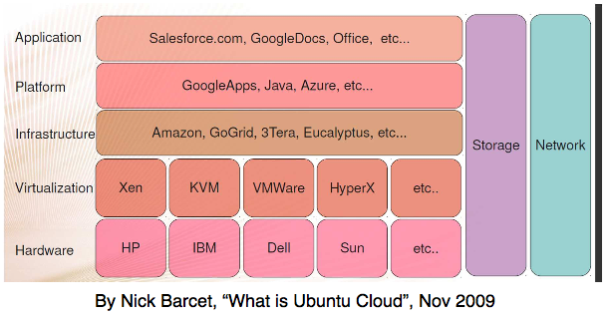
Cloud computing stack

Slide 14
Infrastructure-as-a-Service
Providers give you the computing infrastructure made available as a service. You get “bare-metal” machines.
Providers manage a large pool of resources, and use virtualization to dynamically allocate
Customers “rent” these physical resources to customize their own infrastructure
Full control of OS, storage, applications, and some networking components (e.g., firewalls)

Slide 15
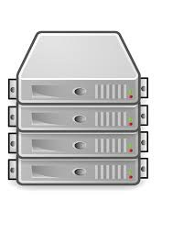
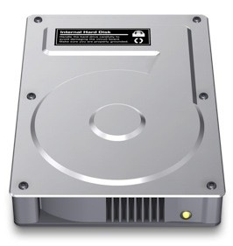
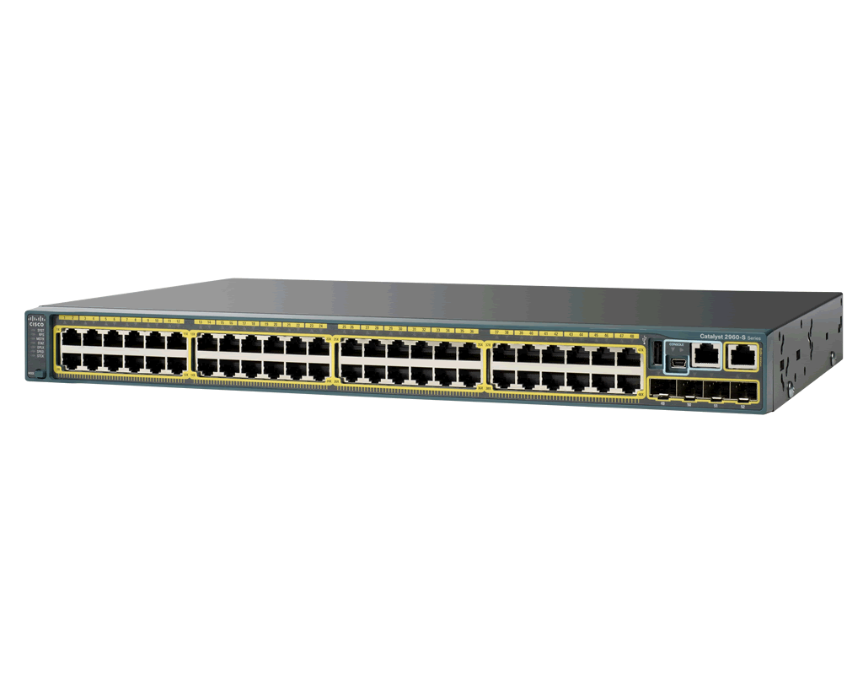
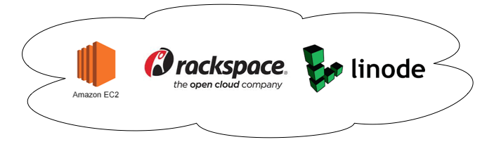
Infrastructure-as-a-Service

Slide 16

IaaS use case
Netflix rents thousands of servers, terabytes of storage from Amazon Web Services (AWS)
Develop and deploy specialized software for transcoding, storage, streaming, analytics, etc. on top of it
Is able to support tens of millions of connected devices, used by 40+ million users from 40+ countries

Slide 17
Platform-as-a-Service (PaaS)
Providers give you a software platform, or middleware, where applications run
You develop and maintain and deploy your own software on top of the platform
The hardware needed for running the software is automatically managed by the platform. You can’t explicitly ask for resources.

Slide 18
PaaS
You have automatic scalability, without having to respond to request load increase/decrease
No control of OS, storage, or network, but can control the deployed applications and host environment
Best for web apps
Language and API support: Python, Java, PHP, and Go

Slide 19
Software-as-a-Service (SaaS)
Providers give you a piece of software/application. They take care of updating, and maintaining it.
You simply use the software through the Internet.

Slide 20

SaaS use case
HKUST uses Google Apps and Office 365 for student and staff email, calendar, etc.
Don’t know how much they charge HKUST though…

Slide 21
Source: K. Remde, “SaaS, PaaS, and IaaS.. Oh my!” TechNet Blog, 2011

Slide 22
A comparison
Flexibility/Customization
IaaS
PaaS
SaaS
Convenience/Ease of management
Tradeoff between flexibility and “built-in” functionality

Slide 23
Why The Cloud?

Slide 24

Cloud Computing Patterns
“Unpredictable Bursting“
“Predictable Bursting“
Compute
Compute
Average Usage
Average Usage
Time
Time
Unexpected/unplanned peak in demand
Sudden spike impacts performance
Can’t over provision for extreme cases
Services with micro seasonality trends
Peaks due to periodic increased demand
IT complexity and wasted capacity

Slide 25

Business Benefits of the Cloud
Top five advantages of cloud computing:
Pay only for what you use
Easy/fast deployment to end users
Monthly payments
Encourages standard systems
Requires less in-house staff, costs

Slide 26

Chief Objections to the Cloud
Top Objections to the Cloud:
Privacy Issues
Security
Control

Slide 27
What about the cloud provider?

Slide 28
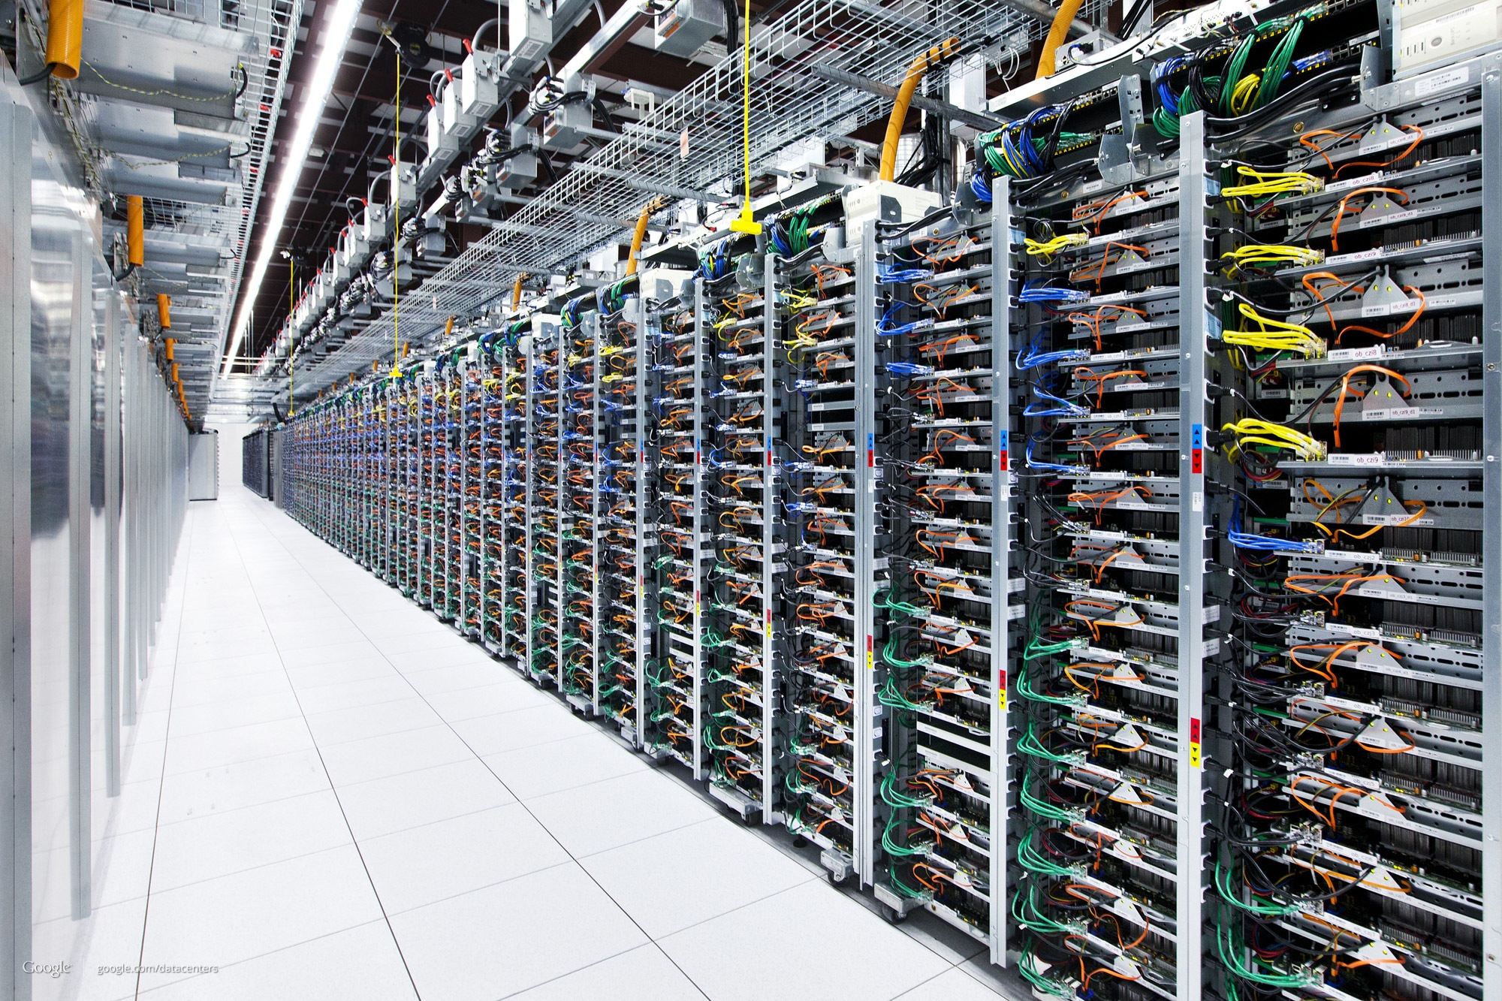
Resource pooling
From the provider’s perspective

Slide 29
Resource pooling
The provider’s resources are pooled to serve consumers using a multi-tenant model, with different physical and virtual resources dynamically allocated according to consumer demand.
Location independence: the customer generally has no control or knowledge over the exact location of the provided resources but may be able to specify location at a higher level of abstraction (e.g., country, state, or datacenter).
Advantage for providers: efficiency in utilization

Slide 30
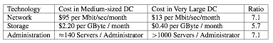
Economy of scale
A medium-sized datacenter (~1k servers) vs. a large datacenter (~50k servers) in 2006
5 - 7x decrease of cost!
Source: Ambrust et al., “Above the clouds: A Berkeley’s view of Cloud Computing.”

Slide 31
Statistical multiplexing

Slide 32
Highly profitable business for Cloud providers

Slide 33
Summary: Why cloud?
Better capital utilization
The unit cost of on-demand capacity may be higher than the unit cost of fixed capacity; offset by no charge when capacity is not being used
Elasticity, easy to scale up and down
Access to complex infrastructure and resources without internal resources
Providers: better resource utilization, lower cost

Slide 34
Microsoft Azure

Slide 35

Global Footprint

Slide 36
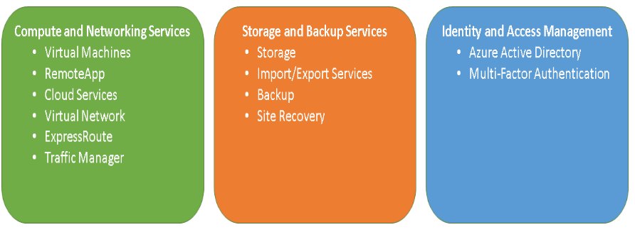
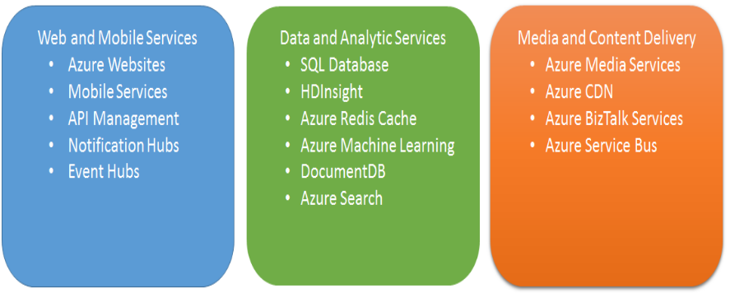
Azure Services

Slide 37
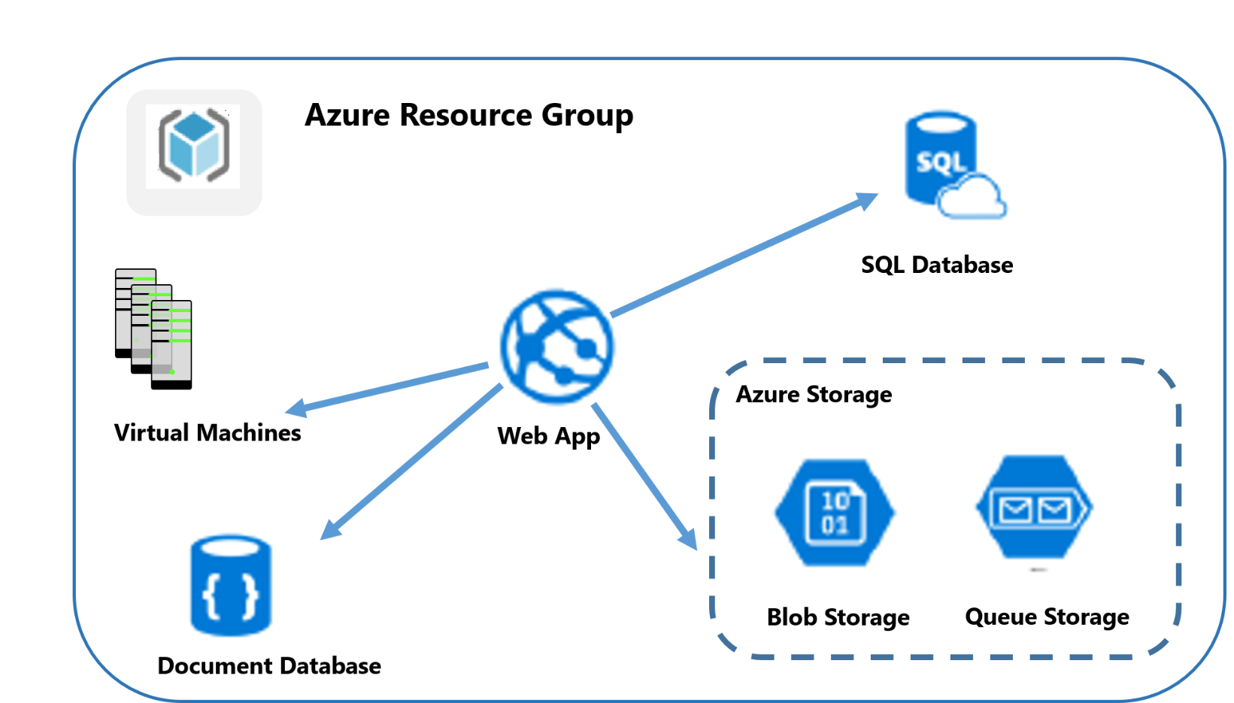
Resource Groups
Grouping Related Services

Slide 38
Azure Storage
Azure Storage Account
Demo: Create a storage account
Download and install Azure Storage Explorer
Upload files to Blob storage

Slide 39
Azure Blobs, Azure Files, or Azure Data Disks
Azure Files: Provides both an SMB interface and a REST interface
Can mount in VMs and use native file system APIs
More expensive: HK$0.6208 per GB per month (LRS)
Azure Blobs: Provides only REST interface
Support data at a massive scale
Cheaper: HK$0.1242 per GM per month (LRS)
Azure Data Disks
Can only be accessed in VMs.
Image files are stored in Blob storage.

Slide 40
Windows Azure Storage Blob (WASB)
WASB is an extension built on top of the HDFS APIs
uses SSL certificates for improved security
replicated 3x within the same data center
more replication if you choose geo-replication
Separate from cluster/VM storage
persist even when no clusters/VMs currently exist (cost less money!)
enables multiple clusters plus other applications to access a single piece of data
one cluster can access multiple storage account
better elasticity than HDFS
same or faster than loading from “local” disks

Slide 41
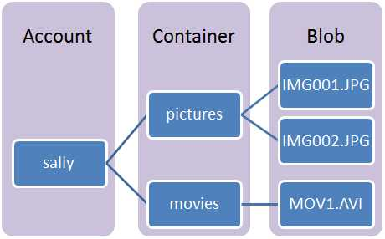
WASB structure
Technically, WASB doesn’t have dictionaries but it recognizes ‘/’ in file names
Example: wasb://YOURDefaultContainer@YOURStorageAccount.blob.core.windows.net/SomeDirectory/ASubDirectory/AFile.txt

Slide 42
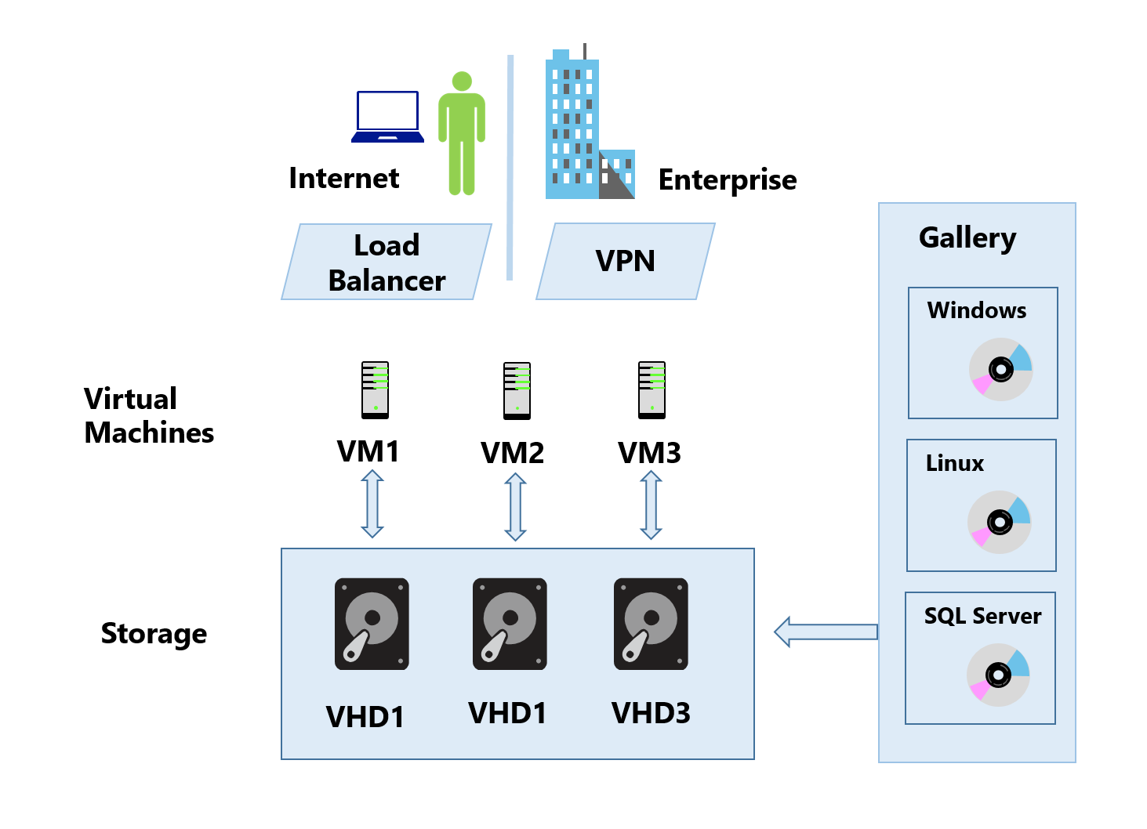
Virtual Machines
Infrastructure as a Service (IaaS)
Provides an operating system, storage, and networking
User needs to maintain the software on the VM
Examples of when to use Virtual Machines
Test and Development
Running applications in the cloud
Disaster recovery

Slide 43
Virtualization
Virtualization is an enabling technology for IaaS Cloud
Suppose an IaaS provider owns a large cluster and wants to provision cloud services for its users
Users require
Different machines with diverse computing capabilities, e.g., CPU, memory, networking, storage, etc.
Different OS, e.g., CentOS, Ubuntu, Windows, etc.
Different softwares and libraries pre-installed, e.g., Python, Java, vim, git, etc

Slide 44
What is virtualization?
Virtualization is a broad term. It can be applied to all types of resources (CPU, memory, network, etc.)
Allows one computer to “look like” multiple computers, doing multiple jobs, by sharing the resources of a single machine across multiple environments.

Slide 45

History
Believe it or not:
virtualization started in 1960’s in IBM’s mainframe

Slide 46
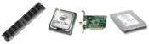
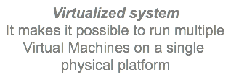
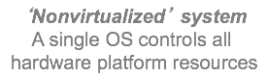
Virtualization
App | App | App
Win | Ubuntu | CentOS
Virtualization layer
App | App
OS

Slide 47
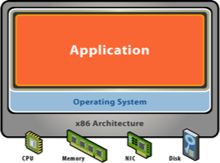
The old model
A server for every application
Software and hardware are tightly coupled

Slide 48
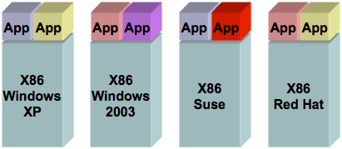
The old model
Big disadvantage: low utilization
10%
12%
18%
20%

Slide 49
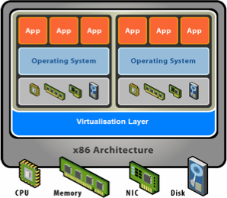
The new model
Physical resources are virtualized. OS and applications as a single unit by encapsulating them into virtual machines
Separate applications and hardware

Slide 50
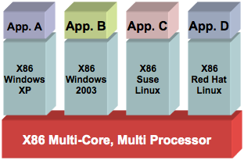
The new model
Big advantage: improved utilization
10%
12%
18%
20%
60%

Slide 51
Virtual networks
You can create multi VMs in the same virtual network
Each VM has two IP addresses:
Public IP Addresses allow VMs to communicate with Internet
Private IP Addresses allows communication between VMs in a virtual network

Slide 52
Demo: Creating a VM
Choose ‘Ubuntu’
Choose ‘HDD’ storage and put it under your storage
Check the storage account for the virtual hard disk (VHD) of your VM
Copy files to the VM:
wget http://d3kbcqa49mib13.cloudfront.net/spark-2.2.0-bin-hadoop2.7.tgz
Temporary disk (SSD) is /mnt
Attach a second data disk
Add a disk in Azure portal
lsblk sudo fdisk /dev/sdc (then type n, …, w) sudo mkfs -t ext4 /dev/sdc sudo mkdir /disk1 sudo mount /dev/sdc /disk1 df
Detach the disk
umount /disk1
Detach in Azure portal
Re-attach to another VM

Slide 53
Setting up a Spark Cluster in Azure
Create a few VMs
Get spark:
wget http://d3kbcqa49mib13.cloudfront.net/spark-2.2.0-bin-hadoop2.7.tgz
tar xf spark-2.2.0-bin-hadoop2.7.tgz
mv spark-2.2.0-bin-hadoop2.7 spark
Install java
Start spark master and slaves as if they were in a local network
You can check the cluster status at hostname:8080
Need to set security rules to allow such inbound traffic

Slide 54
Azure HDInsight
Automatic cluster creation with Hadoop, Spark, etc…
But also more expensive.
Charged every minute whether you use it or not
Benefits over manually created clusters:
Automatic provisioning of clusters, much easier to create and manage
State-of-the-art components
High availability and reliability of clusters (e.g., 2 or more head nodes with Zookeeper)
Easy scaling
Jupyter: demo notebook at https://www.cse.ust.hk/msbd5003/nb/rdd.ipynb

Slide 55
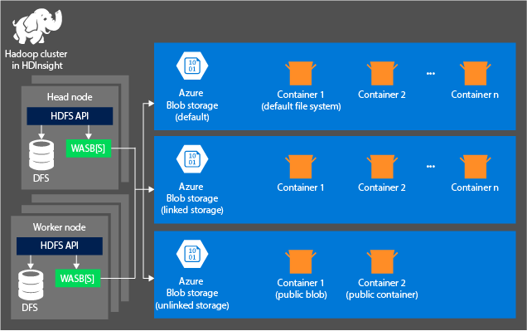
Blob storage in Azure

Slide 56
Pay Attention to Your Balance on Your Azure Pass

